Slide 1

Customer Value Analysis & Sales Drivers
by Daulet Nassakayev
Tools Used: SQL, Python (Pandas, SciPy, Pingouin), Power BI

Slide 2
Business Objective
This project analyzes customer behavior and revenue structure to identify growth opportunities.
What drives revenue differences across segments?
Do discounts increase transaction value?
Is revenue driven by spending behavior or customer volume?
Where are potential growth levers?

Slide 3

Dataset Snapshot
Synthetic retail dataset
Simulates real-world customer behavior
3900 customers
Customer-level data
No time dimension

Slide 4
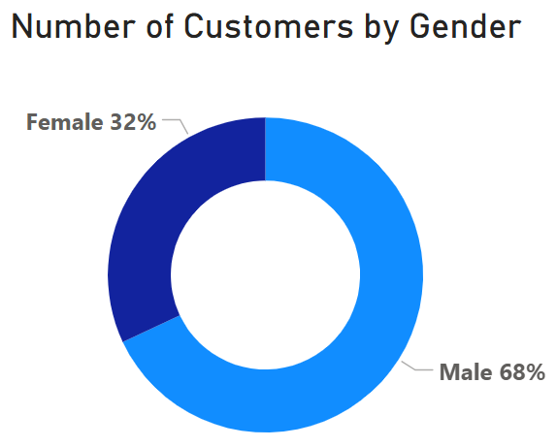
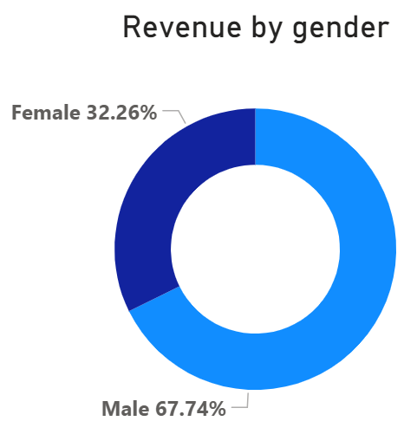
Revenue Structure Overview
Revenue share mirrors customer distribution across segments.
Revenue differences are driven by customer volume, not spending behavior
Average check does not differ significantly across groups
The same pattern is observed across other segments

Slide 5
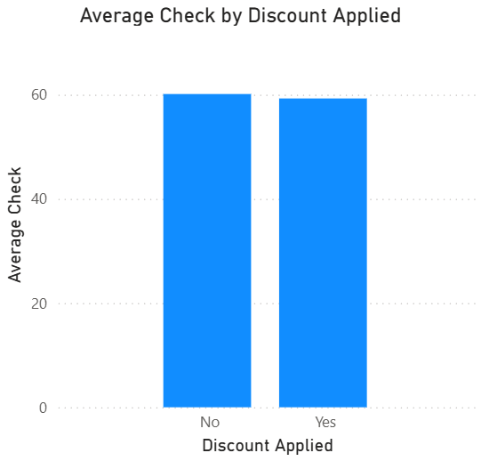
Discount Effectiveness
43% of all orders are discounted
No AOV difference
Unclear profitability

Slide 6
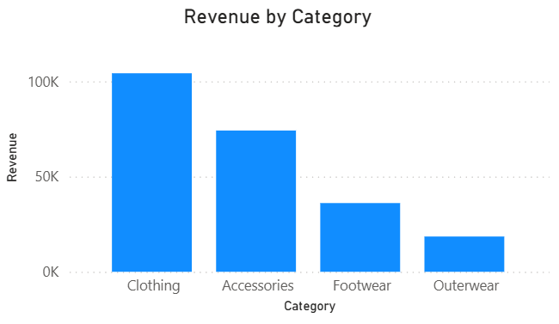
Category & Assortment Insight
76% of revenue comes from two categories
Revenue correlates with SKU count

Slide 7
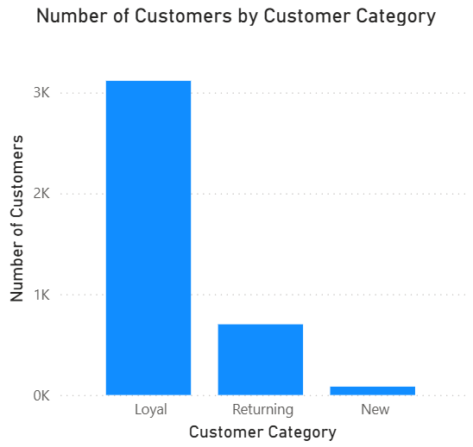
Loyal Customers and Retention
80% of all customers are loyal
New, returning and loyal customers have the same AOV
Analyze customer acquisition trends over time
Strong retention or weak acquisition?
Measure retention rates across customer acquisition cohorts.

Slide 8
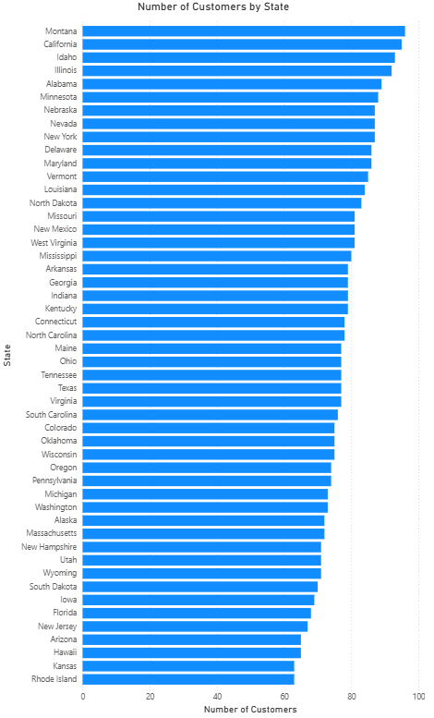
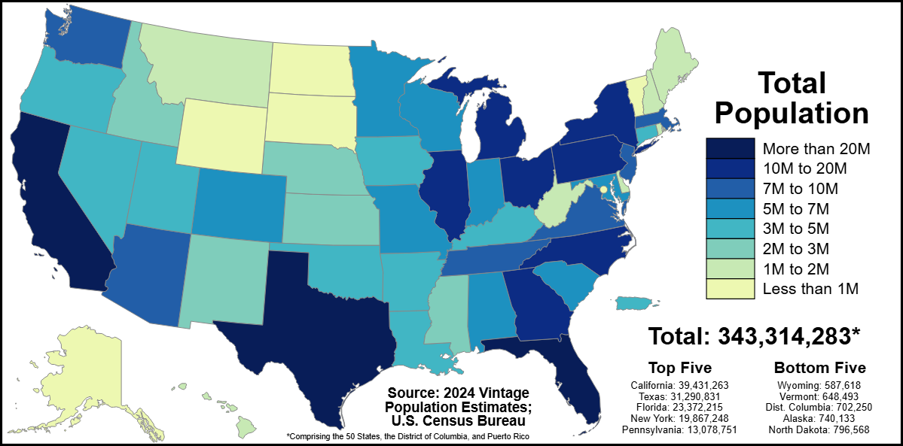
Location-based Analysis
No noticeable difference in customer count.
Difference in population is very significant.
This suggests significant variation in customer engagement rate between states.

Slide 9
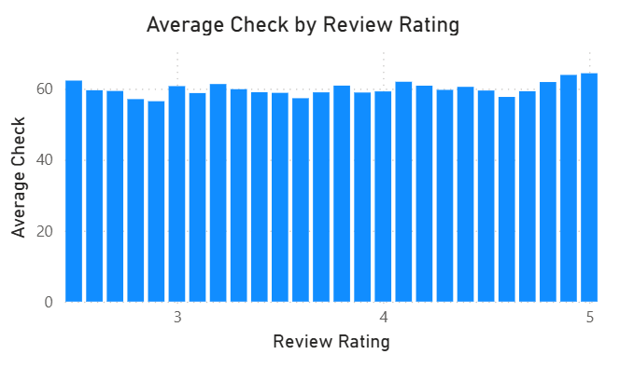
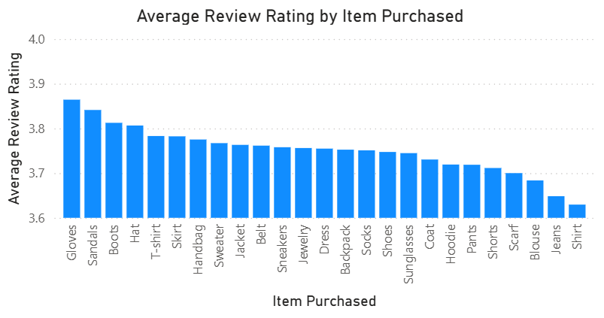
Customer Satisfaction
Review ratings are consistently below 4.0
No spending correlation
Potential brand risk

Slide 10
Strategic Recommendations
Test targeted acquisition campaigns for underrepresented female segment.
Re-evaluate discount strategy (collect discount size and cost data).
Investigate low review ratings to improve customer satisfaction.
Test assortment expansion in underperforming categories (Footwear, Outerwear).
Implement location-based marketing in underpenetrated states.

